Slide 1




Low-Cost Precipitation Phase Partitioning Using Acoustic Data and Machine Learning in the Edge
Christian Skalka, Rachael Chertok, Julia Sober, Soheyl Faghir-Hagh, Tian Xia

Slide 2
Precipitation Phase Partitioning with IoT Sytems
Precipitation phase partitioning: an important, difficult problem for alpine snow hydrology.
E.g., Rain on snow detection: one of the 23 unsolved problems in hydrology [1]
How to detect rain vs. sleet vs. snow with ground-based sensors?
Existing sensors (e.g., disdrometers) are expensive and power-hungry.
Poor spatial resolution- but high spatial variability of phase in alpine settings.
Our approach: Low-cost AI enabled IoT systems, using acoustic sensors.
Modern platforms (e.g., Arduino) highly programmable, low power/cost.
Low cost/power/size = better spatial resolution.
[1] Gunter Bloschl, Marc FP Bierkens, Antonio Chambel, Christophe Cudennec, Georgia Destouni, Aldo Fiori, James WKirchner, Jeffrey J McDonnell, Hubert HG Savenije, Murugesu Sivapalan, et al. Twenty-three unsolved problems in hydrology–a community perspective. Hydrological sciences journal, 64(10):1141–1158, 2019

Slide 3
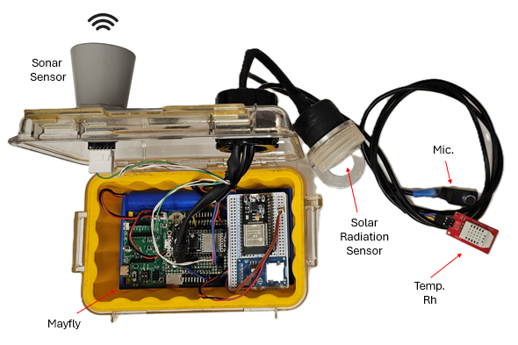
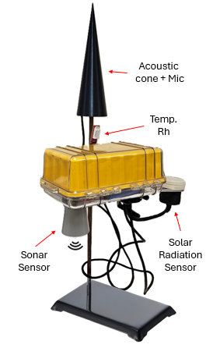
Low-Cost Arduino Sensor Platform
Phase partitioning can be integrated into a complete snow sensor system (incl. snow depth, temp/rh, others).
Precipitation phase detection, summary:
Audio data recorded via a microphone.
Audio features extracted from this audio via signal processing.
Features provided to ML models, previously trained to classify precipitation phase.
Critical to embed the entire prediction workflow on device.
Streaming sound data is too costly for remote near-real-time reporting or even storage.
Smart sampling ensures conservative use of mic.

Slide 4
Detection Algorithm Flowchart
If dew point > 100 - ε
No: Wait x minutes, then resample
Yes
Microphone
.wav file
Audio Signal in Time Domain
Fast Fourier Transform (FFT)
Short Time Fourier Transform (STFT)
Extract features from time domain
Extract Features from frequency domain (spectrogram)
MFCCs
Use as input features to ML models: SVM and Random Forests
Outputs: Classified precipitation phase
Light rain, heavy rain, light hail, heavy hail, snow, silence

Slide 5
Machine Learning Technologies
Models must be able to fit on embedded device (nonvolatile and program memory).
Rules out deep learning architectures.
Algorithms we’ve evaluated:
Random Forests
Support Vector Machines (SVM)
XGBoost (ruled out, too computationally expensive)
Logistic Regression (too simple for this data, did not converge)
Signal processing performed to extract audio features:
Time domain: four possible temporal features.
Frequency domain: 12 possible spectral features.
MFCCs: 13 Mel Frequency Cepstral Coefficients.

Slide 6
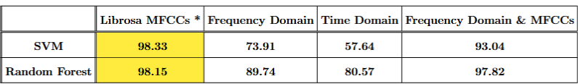

Machine Learning Results with Simulated Data
Input features to ML models retrieved from simulated and real data, using our recording device setup.
Current model results, on synthetic data, as follows (in percentages):
*Not yet implemented on device

Slide 7
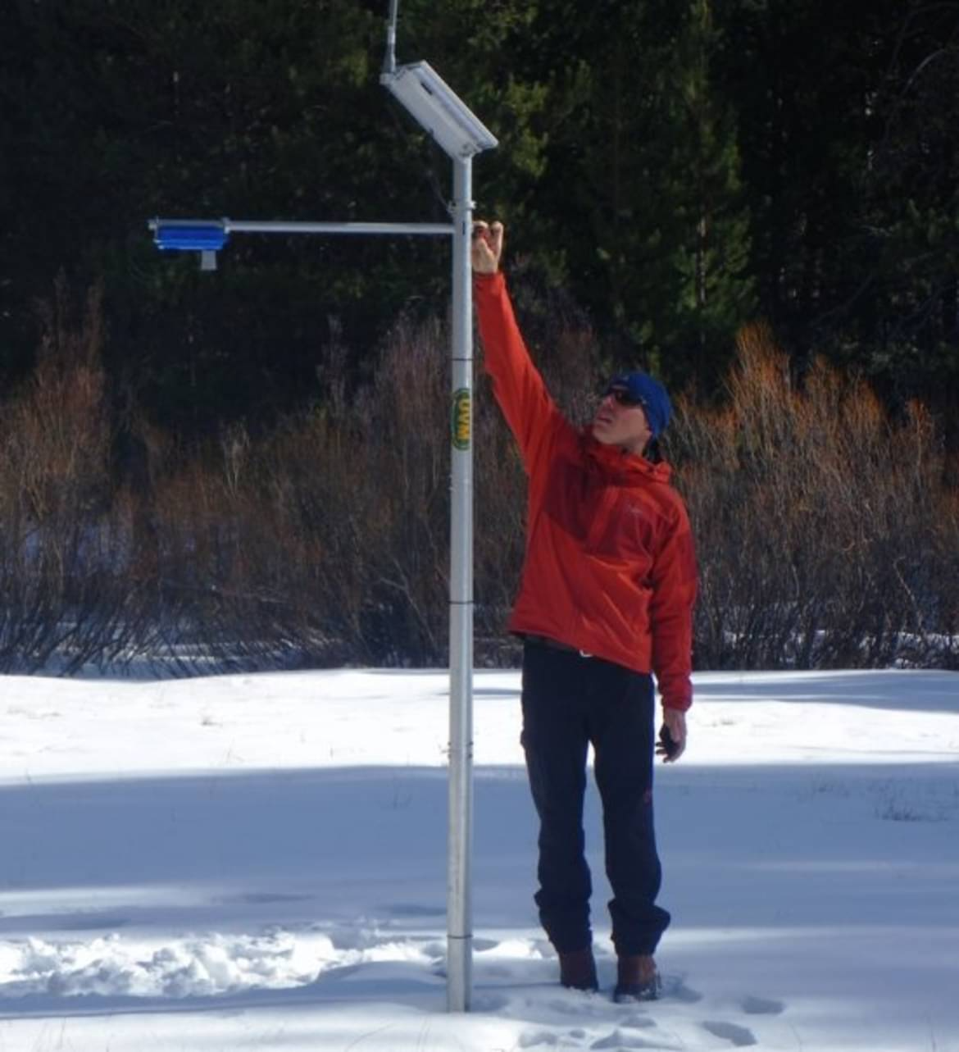
Current and Future Work
Collecting real weather audio (in process) (mention deployment?).
Refining models using real data
Refining hardware for remote IoT-based sensor network deployments.
Local area networking via LoRA.
Near real time reporting via satellite uplink.
Integration with full snow hydrology sensor suite:
Snow depth, soil moisture, temp/RH.
Concluding note?

Slide 8
Supplemental Slides

Slide 9

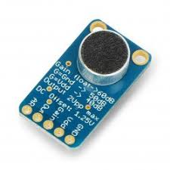

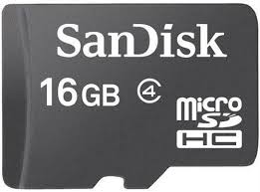

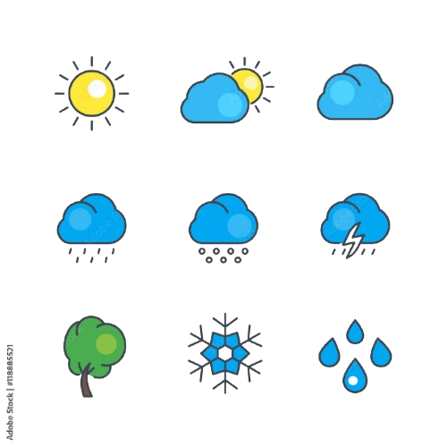
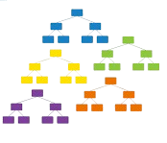
MFCC Extraction Flow Chart
Microphone
Record .wav files onto the SD card
ADC
Pin A0
Read the .wav file from SD
Apply Windowing
Calculate and Save MFCCs onto the SD card
Log and Discrete Cosine Transform
Mel Filter Bank
Discrete
Fourier
Transform
1. Heavy hail
2. Light hail
3. Heavy rain
4. Medium rain
5. Light rain
6. Snow
7. Silence
Feed the MFCCs to the Random Forest
Model
Read the MFCC.csv
from SD
Results

Slide 10
Features Extracted from Audio
Temporal Features:
Average Autocorrelation Coefficient*, Average Zero Crossing Rate*, Temporal Entropy, Acoustic Complexity Index
Spectral Features:
Spectral Entropy, Spectral Cover Low Frequency Coverage, Spectral Cover Mid Frequency Coverage, Spectral Cover High Frequency Coverage, Spectral Flux, Spectral Centroid, Spectral Spread, Spectral Skewness, Spectral Kurtosis, Spectral Bandwidth, Spectral Flatness, Spectral Rolloff
MFCC Details:
13 MFCC coefficients extracted
When performing this in Librosa, 1024 points in the FFT were used
When performing with our own function, 256 in the FFT were used.
*For some features, like Autocorrelation Coefficient, many values are outputted for each sample. To cut down on the number of features inputted to the model, we average these values together for each .

Slide 11
To be added back in? (or removed)
Power and memory usage: Max ~30mA during prediction workflow, 16KB RAM.

